Slide 1
Learning Objective
I will solve contextual quadratic problems.
Success Criteria
At the end of the lesson, I will be able to:
Solve contextual quadratic problems

Slide 2
Concept Development
Solving problems using quadratic problems involves the following steps:
Step 1: Use a variables to define an unknown value
Step 2: Form an equation using the key words in the stated problem and the variable
Step 3: Solve the equation
Step 4: Answer the question in words

Slide 3
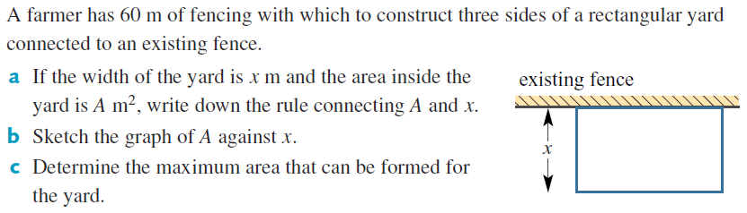
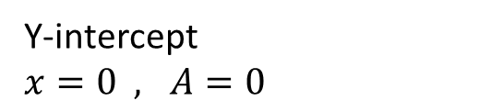

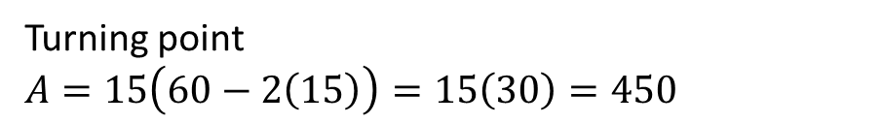

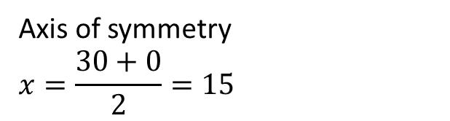
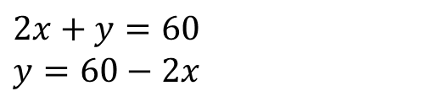

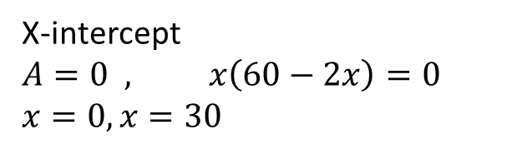

Cambridge Ex 3L Q1
Let $y=$ Length of fence
$$2x+y=60$$ $y=60−2x$
$$A=xy$$
$$A=x(60−2x)$$
Y-intercept
$x=0 , A=0$
X-intercept
$$A=0 , x\left(60−2x\right)=0 \\ x=0, x=30$$
Axis of symmetry
$$x=\frac{30+0}{2}=15$$
Turning point
$$A=15\left(60−2\left(15\right)\right)=15\left(30\right)=450$$
Maximum Area, $A=450 m^{2}$

Slide 4
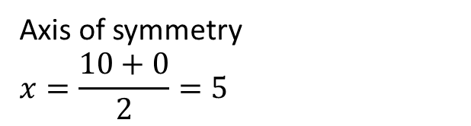
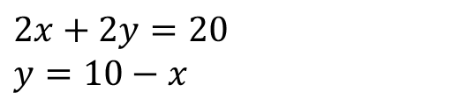
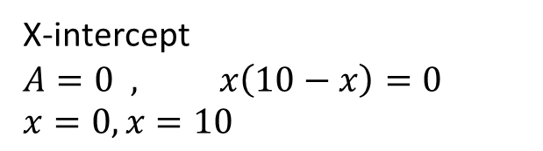



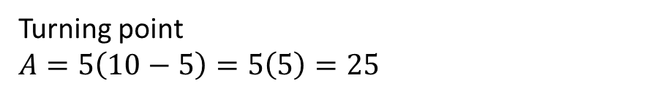
Cambridge Ex 3L Q2
Let $y=$ Length of rectangle
$$2x+2y=20 \\ y=10−x$$
$$A=xy$$
$$A=x(10−x)$$
Y-intercept
$x=0 , A=0$
X-intercept
$$A=0 , x\left(10−x\right)=0 \\ x=0, x=10$$
Axis of symmetry
$$x=\frac{10+0}{2}=5$$
Turning point
$$A=5\left(10−5\right)=5\left(5\right)=25$$
Maximum Area, $A=25 m^{2}$

Slide 5
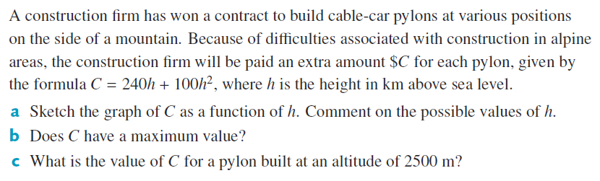
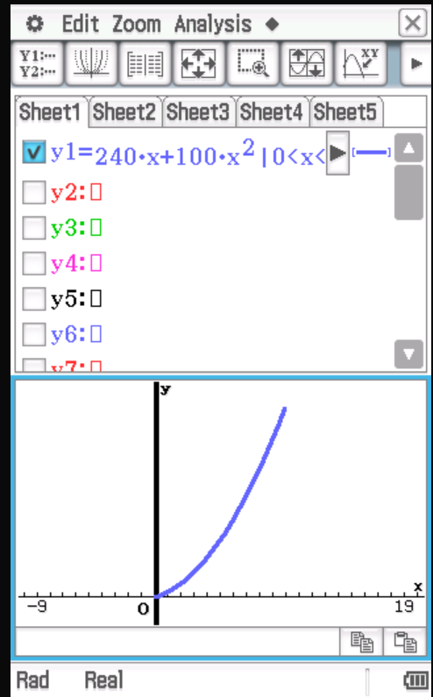
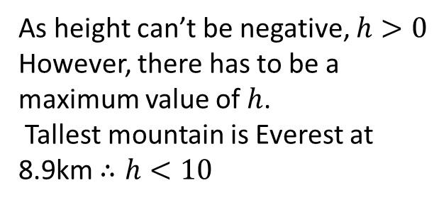


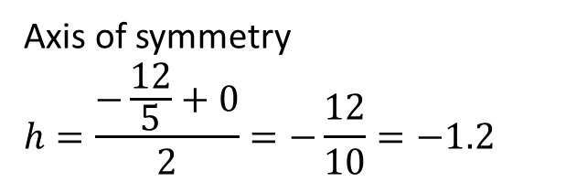
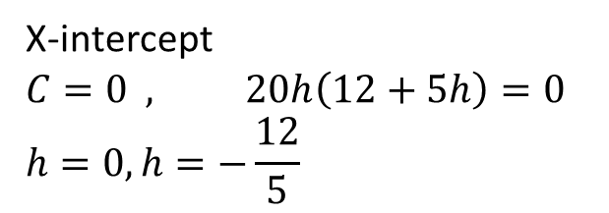
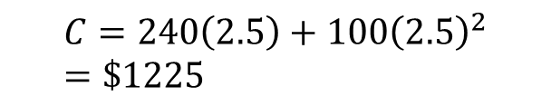
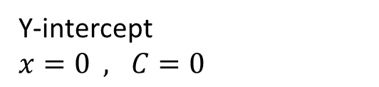
Cambridge Ex 3L Q6
$$C=240h+{100h}^{2}$$
$$C=20h(12+5h)$$
Y-intercept
$x=0 , C=0$
X-intercept
$$C=0 , 20h\left(12+5h\right)=0 \\ h=0, h=−\frac{12}{5}$$
Yes as height can only be up to a certain amount.
Axis of symmetry
$$h=\frac{−\frac{12}{5}+0}{2}=−\frac{12}{10}=−1.2$$
$$C=240\left(2.5\right)+{100\left(2.5\right)}^{2}=\$1225$$
As height can’t be negative, $h>0$ However, there has to be a maximum value of$h$.
Tallest mountain is Everest at 8.9km $∴h<10$

Slide 6
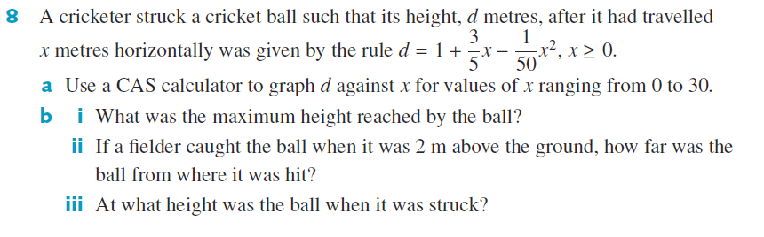
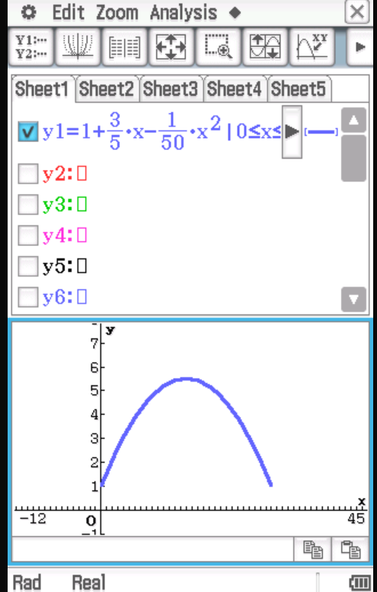
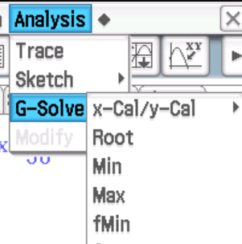
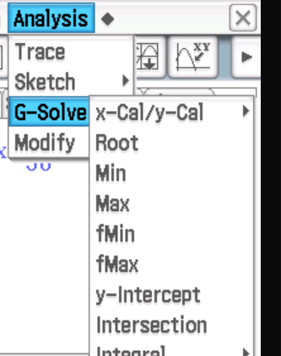
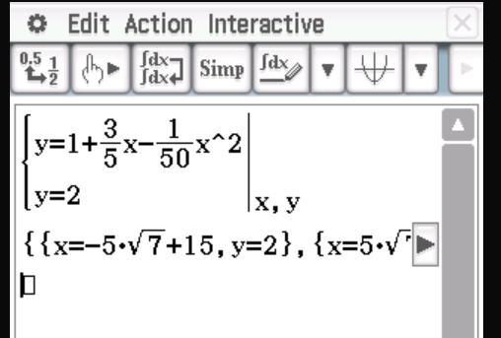
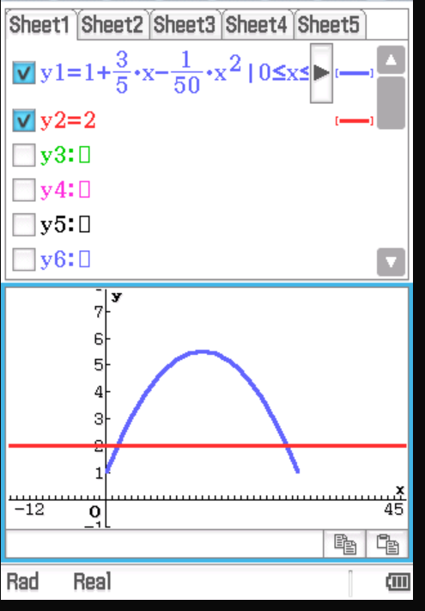
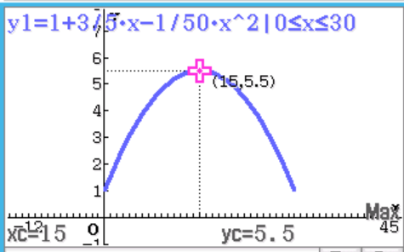
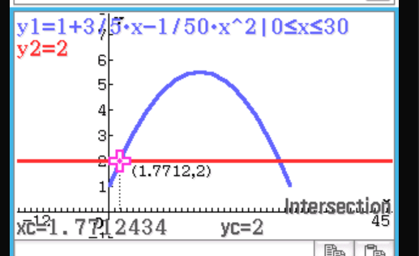
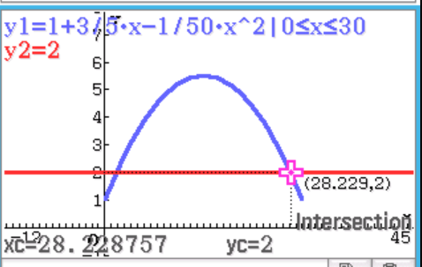
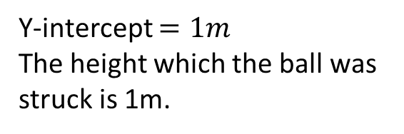

Cambridge Ex 3L Q8
Max height $=5.5m$
Y-intercept $=1m$
The height which the ball was struck is 1m.

Slide 7
Independent Practice
Complete Cambridge Ex 3L

